Slide 2
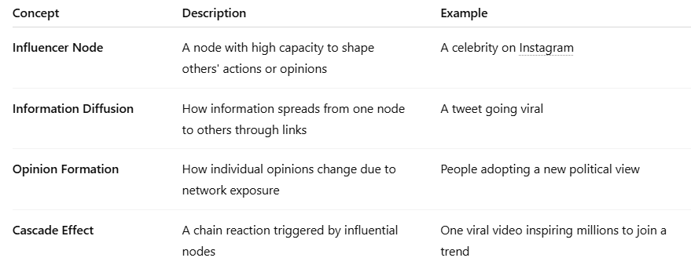
Key Concepts of Influence in SNA

Slide 3
Metrics to Measure Influence
Degree Centrality
Measures the number of direct connections a node has.
High degree centrality = more immediate reach.
Example: A user with many followers.

Slide 4
Metrics to Measure Influence
Betweenness Centrality
Measures how often a node acts as a bridge between other nodes.
Influencers here control information flow.
Example: A journalist who connects multiple communities.

Slide 5
Metrics to Measure Influence
Closeness Centrality
Indicates how close a node is to all others in the network.
High closeness = can spread information quickly.

Slide 6
Metrics to Measure Influence
Eigenvector Centrality
Considers not just the number of connections, but their quality (importance of neighbors).
Example: A user followed by other influential users.

Slide 7
Metrics to Measure Influence
PageRank
Similar to eigenvector centrality; gives more weight to influential connections.
Widely used in web and social media analysis.

Slide 8
Metrics to Measure Influence

